Slide 1
COVID-19
EMPLOYEE ORIENTATION to CAMPUS
COVID-19: EMPLOYEE ORIENTATION

Slide 2
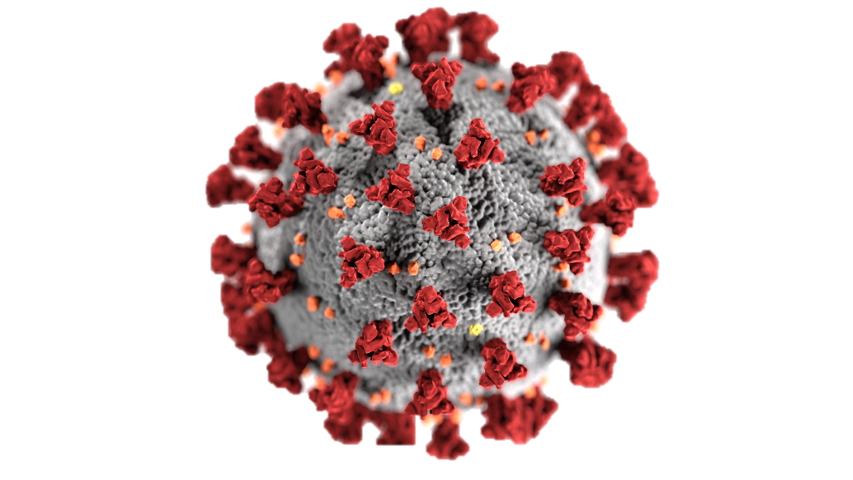

COVID-19 What Is It?
COVID-19 is a disease resulting from exposure to a family of viruses called the coronaviruses
A mild example is the common cold
Extreme examples are
SARS- Severe Acute Respiratory Syndrome and,
MERS- Middle East Respiratory Syndrome

Slide 3



HOW DOES THE VIRUS GET INTO YOUR BODY?
MOUTH
EYES
NOSE

Slide 4
So What Happens When You
Get EXPOSED?
It attaches to the ACE2 receptors in the body, which is a protein that lines many of our organs (lungs, heart, blood vessels, kidneys, liver, GI tract)
Once it attaches to these proteins, it causes inflammation
This can overwhelm your immune system
Under certain conditions (increased risk factors discussed later), there is an increased risk of experiencing severe symptoms of the COVID-19, or even death
Notes:
Slide 5
Remove the whole line “there are 2 ways to get infected”
Change to
Exposure to infection can overwhelm…
Exposure can also overwhelm…

Slide 5

COVID-19 Symptoms
As of Oct. 1, 2020, Nova Scotia health advises all individuals who feel they need to be assessed to perform an online COVID-19 Assessment (see link below). If you are unable to access the online version, you can still call 811 for a telephone assessment. If you are currently experiencing or have experienced the following COVID-19 symptoms in the last 48hrs please follow the link below.
OR
Fever
(chills, sweats)
Cough
(new or worsening)
SYMPTOMS CONTINUE

Slide 6
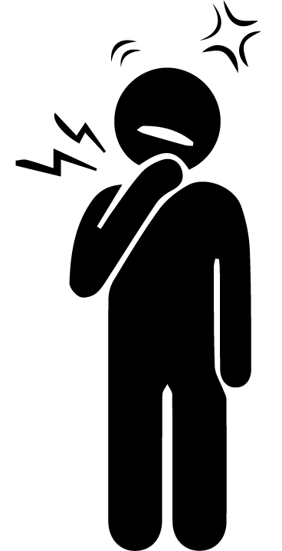


…OR Two Or More Of The Following Symptoms
(New Or Worsening):
Sore throat
Runny nose
Headache
Shortness of breath

Slide 7
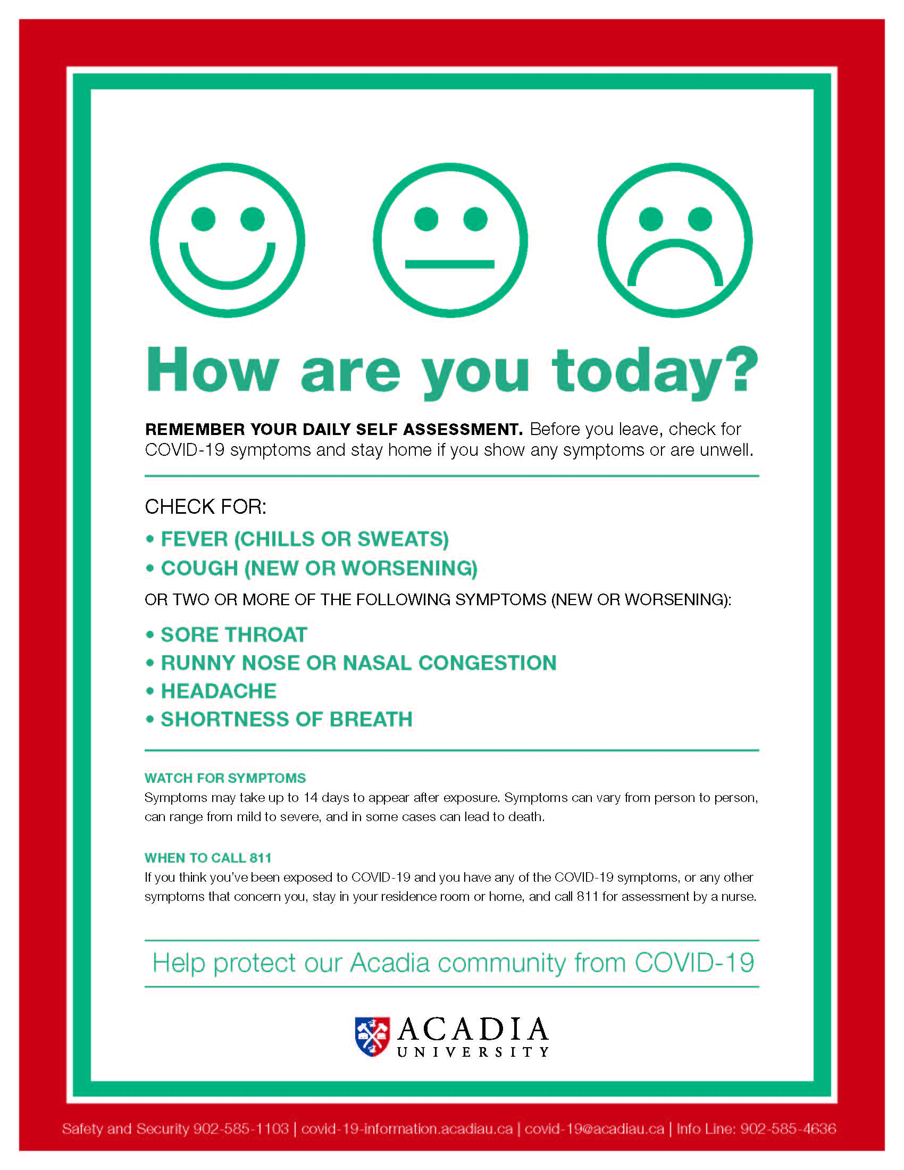

Slide 8
WHEN ELSE DO YOU Need To Be Assessed For COVID-19?
If you think you have been exposed to COVID-19 by being in proximity of a positive case of COVID-19, or
Are experiencing any other symptoms that concern you
If you are asked to isolate, please inform your immediate supervisor and depending on the severity of your symptoms, discuss work options at that time

Slide 9


Symptom Timeline
Once you are exposed to the infection;
It can take as little as 1 to 2 days to develop symptoms, or up to 14 days.
Therefore, the government has implemented a 14-day
quarantine (self-isolation) period in Nova Scotia.
The average; however, is generally 5 to 6 days for symptoms to show

Slide 10

Recovery
Mild cases can take 1 to 2 weeks to recover
Severe cases can take longer than 6 weeks and may or may not cause permanent damage to your organs

Slide 11
Risk Factors which make you more vulnerable to Developing COVID-19
• People of any age with chronic medical conditions including:
• Lung disease
• Heart disease
• Hypertension (high blood pressure)
• Diabetes
• Kidney disease
• Liver disease
• Dementia
• Stroke

Slide 12
Risk Factors which make you more vulnerable to Developing COVID-19
People of any age who are immunocompromised, including those:
  With an underlying medical condition (e.g., cancer)
  Taking medications that lower the immune system (e.g., chemotherapy)
People living with obesity (BMI of 40 or higher)
Older adults (increasing risk with each decade, especially over 60 years)

Slide 13
Different Categories of Infection
Once you are infected you are either:
Asymptomatic
(no symptoms for the duration)
Pre-symptomatic
(Currently exhibiting no symptoms but will eventually develop symptoms)
Symptomatic
(Currently exhibiting symptoms)
The World Health Organization (WHO) believes that once you are infected, you have the potential to infect others, regardless of the degree of symptoms you are exhibiting.
In fact, the WHO also believes that you are more likely to infect others around the time you are experiencing the onset of symptoms

Slide 14

How Does it Spread?
Through respiratory droplets
Close prolonged contact (defined as 15 minutes)
Touching an infected area and then touching your eyes, nose or mouth
It can survive on surfaces outside the human body for
Up to 3 hours as an aerosol
Up to 72 hours on plastic and stainless steel
Up to 4 hours on copper
<24 hours on cardboard

Slide 15
WHAT CAN the government do TO BREAK THE
CYCLE OF INFECTION?
Canada and the Nova Scotia governments have implemented a standard prevention method to limit the spread of coronavirus within our communities.
Therefore, you must quarantine (self-isolate)/ isolate immediately upon arrival in Canada
You must continue to quarantine (self-isolate)/ isolate for 14 days after arrival in Nova Scotia, with your arrival day in Nova Scotia being considered Day 1.

Slide 16
Clarifying QUARANTINE (SELF-ISOLATION) vs isolation
Quarantine (Self-isolation)
Restricting activities and/or separating people who are not ill, but may have been exposed to COVID-19 (such as travelers)
This can take place in a designated facility or at home for 14 days (see federal guidelines for international students in the reference section)
Isolation
Separating people who are ill with symptoms of COVID-19 and/ or have tested positive

Slide 17
So what has Acadia University done to make it safe for everyone?
We have followed the Hierarchy of Controls and implemented the following policies and protocols on campus:
Elimination Controls
Substitution Controls (not applicable)
Engineering Controls
Administrative Controls
PPE (personal protective equipment)

Slide 18

1. Elimination Controls
Avoided exposure by…
  Working off campus
  Staggering classes
  Developing online learning
  Daily online self-assessment (If you feel unwell-STAY home or in your residence)
  Virtual meetings for faculty, staff and students

Slide 19
3. Engineering Controls
Physical distancing measures have been implemented
Minimizing the use of common areas to follow provincial directives related to COVID-19
Restructuring office space and classrooms to allow for increased physical distancing
Restricting numbers of occupants in elevators and small spaces
Physical barriers have been implemented where physical distancing is not possible (following provincial directives)
One-way traffic flow has been implemented in buildings and stairwells around the campus
Increased the number of handwashing stations in high traffic areas
Re-routed some ventilation to bring in more fresh air into the buildings on campus

Slide 20
4. Administrative Controls
Implemented policies, procedures, and protocols to maintain safety and compliance with provincial directives
Educated faculty, staff and students on COVID-19 awareness, prevention and importance of compliance
Increased number of cleanings in high touch areas and high traffic areas (above routine cleaning) such as doorknobs, light switches, and faucets
Staggered class start times and moved class locations to consider maximum occupancy
Staggered mealtimes and break times
Advanced planning, clear communication, and appropriate training, regarding addressing potential positive COVID-19 cases

Slide 21
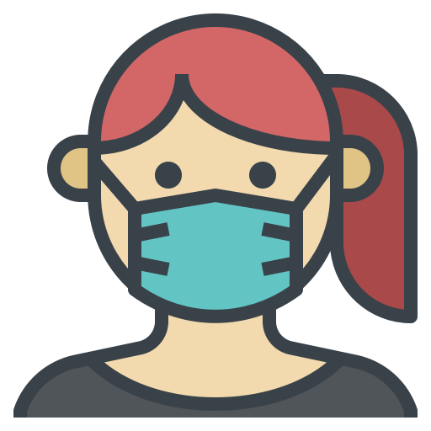
5. Personal Protective Equipment (PPE)
PPE is used when other controls cannot be met
Wear a mask (bring your own or use supplied Acadia masks)
Launder non-medical cloth masks appropriately after each use
Face shields, gloves, gowns, and 3-ply disposable face masks will be supplied to those individuals that may encounter someone with potential symptoms while in the course of their duties (e.g., quarantine/ self-isolation/ isolation periods)

Slide 22
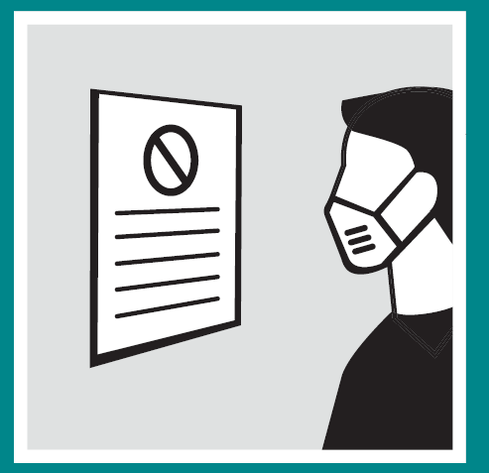

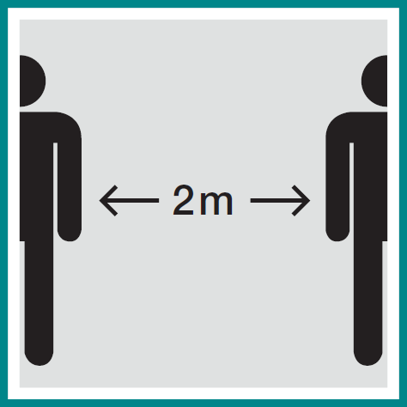
What Can YOU Do to prevent infection?
Stay informed and follow Canadian Public Health directives
Clean high touch areas in your living space routinely
Practice 2-metre
(6-foot) distancing

Slide 23
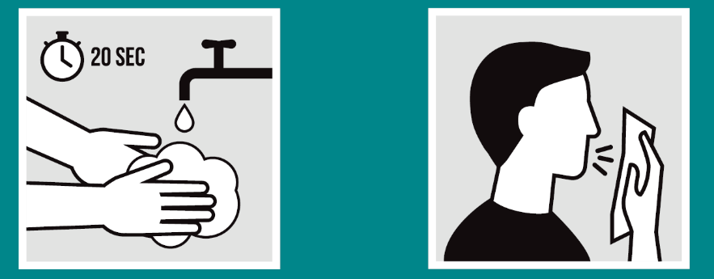

What else can YOU do?
Practice good cough etiquette
Use a tissue - Wash your hands
Cough or sneeze into your elbow - Wash your hands
Avoid touching your eyes, nose, and mouth - Wash your hands
Notes:
• Know and Sign the Student Code of Conduct Pledge

Slide 24
IMPORTANCE OF A MASK
Wear a mask especially when you are unable to maintain social distancing of 2 metres (6 feet).
Review and follow Acadia’s COVID-19 Mask Policy (see link below).
Anyone who needs an exemption from wearing a mask is asked to contact Safety and Security for assistance (see contact info below).

Slide 25

What else Can you Do?
Stay healthy to maintain a good immune system
Exercise routinely
Maintain good nutritional habits
Get adequate and routine sleep

Slide 26
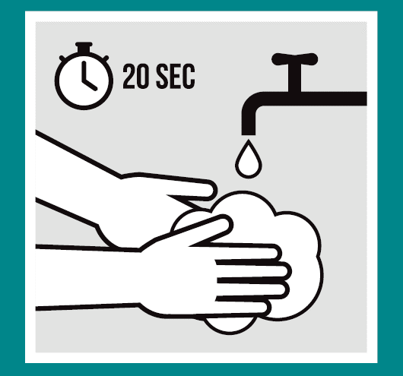
Most Importantly
Practice good hand hygiene.
Wash your hands…
  Before and after preparing food
  After touching pets
  After handling waste or dirty laundry
  After going to the washroom
  When your hands look dirty
  After touching surfaces used by others

Slide 27
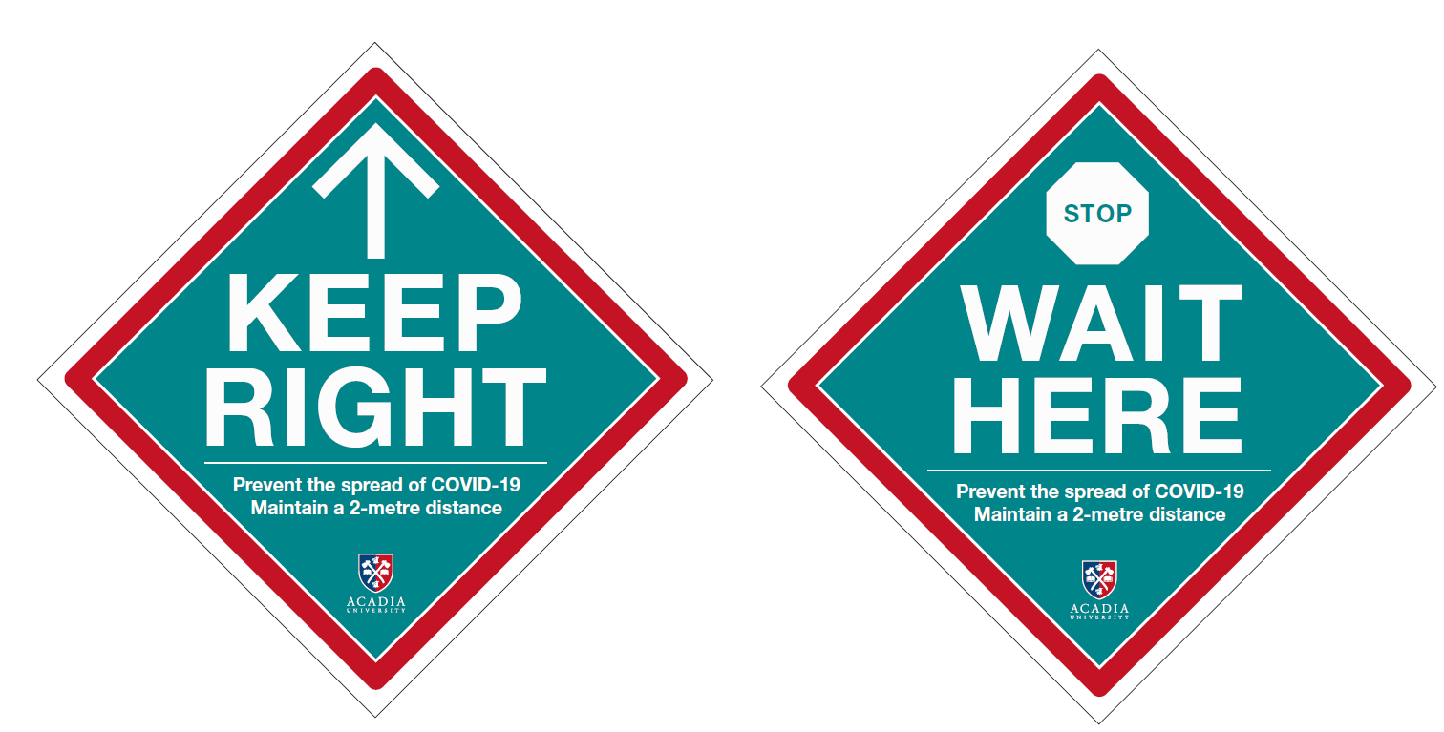
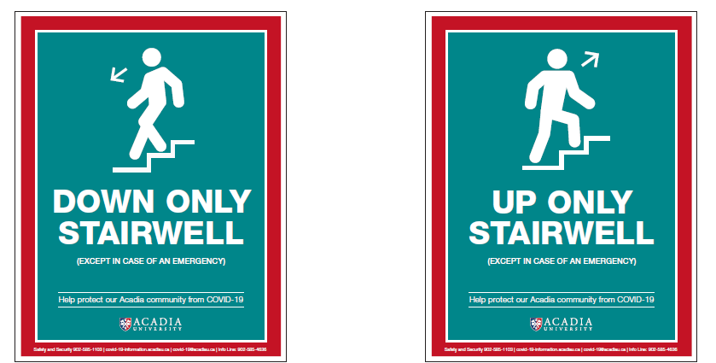

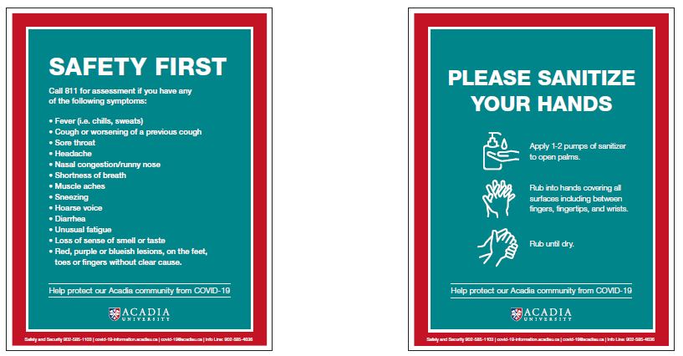
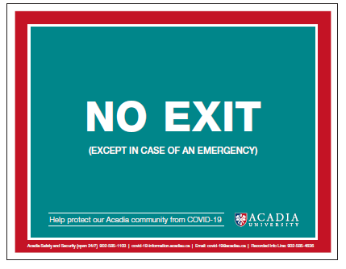
Campus Signage EXAMPLES:

Slide 28
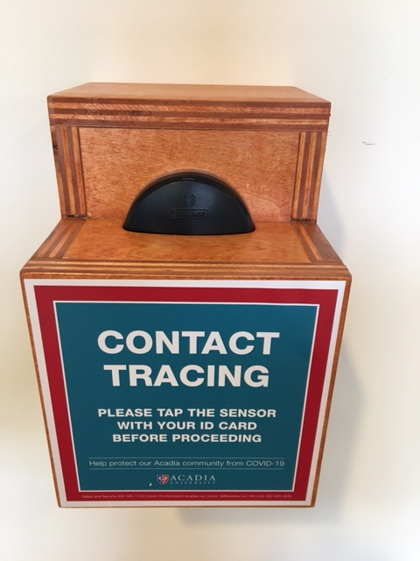
Contact tracing on campus
CCTV
RFID scanners at building entrances,
Class attendance records,
Acadia Wi-Fi, and
Electronic Access Controls.

Slide 29

COVID-19 APP
Ensure to be notified of any COVID-19 exposure immediately
Download the COVID APP today
https://novascotia.ca/coronavirus/covid-alert-app/

Slide 30


PERSONAL Safety During COVID-19
Although there is one-way traffic into and out of the buildings on campus, it is important to know that in the conditions of an evacuation or fire alarm you should find the nearest exit and evacuate in a calm manner. In the interest of safety, it is not necessary to follow the one-way traffic pattern.
Regarding masks, if you find someone who is incapacitated or vomiting while wearing a mask, please remove their mask so they do not aspirate and potentially die.

Slide 31
What is expected from acadia university FACULTY & Staff?
All members of the Acadia community are required to do a daily self-assessment of symptoms and avoid leaving home or residence, if they feel unwell. The Self-Assessment is available on the COVID-19 website. If faculty & staff answer yes to any symptoms they are advised to stay home and follow the instructions on the website.
Before returning to campus, Acadia’s faculty and staff must confirm they have read The Campus Reopening Framework and pledge their commitment by completing the Return to Campus Agreement.
Acadia faculty & staff are required to adhere to Acadia’s Mask Policy. If you need an exemption, please refer to Acadia’s Mask Policy for direction.

Slide 32
What is expected from acadia students?
Acadia students are required to do a daily self-assessment of symptoms and avoid leaving home or residence, if they feel unwell. The Self-Assessment is available on the COVID-19 website. If you answer yes to any symptoms you are advised to stay home and follow the instructions on the website.
You are required to adhere to Acadia’s Mask Policy. If you need an exemption, please refer to Acadia’s Mask Policy for direction.
Students returning to campus are required to review and confirm their commitment to the Student COVID-19 Safety Pledge.
Notes:
Reviewing Code of Conduct – Adaptation of Res version with update
Review & Sign off on Pledge
SYMPTOMS:
Stay home and Call 811
If you are asked to self isolate – call Safety and security

Slide 33
Resource & REFERENCE LINKS
Acadia’s Self-Assessment & Self Isolation Guide - https://www2.acadiau.ca/covid-19/self-assessment.html
Nova Scotia’s 811 Self-Assessment Guide - https://when-to-call-about-covid19.novascotia.ca/en
Acadia’s Health Centre - https://www2.acadiau.ca/student-life/health-wellness/clinic.html
Acadia’s Counselling Centre - https://www2.acadiau.ca/student-life/health-wellness/mental-health.html
Nova Scotia Healthy Minds Online Support – https://healthymindsns.ca/schools/acadia/
Acadia’s Chaplaincy – https://chapel.acadiau.ca/chaplain.html
Acadia’s Mask Policy - https://www2.acadiau.ca/covid-19/health-and-safety.html
Acadia’s Campus Reopening Framework - https://www2.acadiau.ca/files/files/COVID-19/CampusReopeningFramework.pdf
Acadia’s Staff & Faculty Return to Campus Agreement -https://forms.office.com/Pages/ResponsePage.aspx?id=7sy4OP2s60CXLlUtfNVIo72sHQMh1htPvrhWmNOcupBUMVAxR0tHTDM2MjNGRERVR1VPSVlKRlpLMS4u
Acadia’s Occupational Health Nurse COVID-19 cell: 902-698-9221

Slide 34
COVID-19 Preparedness & EDUCATION CONTENT References
https://novascotia.ca/coronavirus/masks/
https://theconversation.com/what-is-the-ace2-receptor-how-is-it-connected-to-coronavirus-and-why-might-it-be-key-to-treating-covid-19-the-experts-explain-136928
https://www.canada.ca/en/public-health/services/diseases/coronavirus-disease-covid-19.html
https://www.cdc.gov/coronavirus/2019-ncov/need-extra-precautions/people-with-medical-conditions.html
https://www.hopkinsmedicine.org/health/conditions-and-diseases/coronavirus/diagnosed-with-covid-19-what-to-expect#:~:text=Those%20with%20a%20mild%20case,will%20die%20from%20the%20disease.
https://www.nejm.org/doi/10.1056/NEJMc2004973
https://www.who.int/
https://www2.acadiau.ca/covid-19.html
https://www.canada.ca/content/dam/phac-aspc/documents/services/publications/diseases-conditions/people-high-risk-for-severe-illness-covid-19/people-high-risk-for-severe-illness-covid-19-eng.pdf
https://www.who.int/emergencies/diseases/novel-coronavirus-2019/question-and-answers-hub/q-a-detail/coronavirus-disease-covid-19

