Slide 1
Cave Syndrome and Anxiety
Moving Forward

Slide 2
What is Cave Syndrome?
A non-medical term coined by psychiatrist Dr. Arthur Bregman.
Basically it is the fear and anxiety of going out and re-joining society post COVID-19 pandemic.
Ranges from extreme fear to simply being uncomfortable.
This fear can jeopardize your life and your career.
Some hesitancy is normal, but
Clinically severe cases where you are not able to leave your house, you should be seeking professional help to alleviate these anxieties.

Slide 3
Understanding the Process
Watch this 6 minute video to help you understand the risks and your decision process:
https://www.wsj.com/articles/fully-vaccinated-but-anxious-about-a-return-to-normal-life-you-may-have-cave-syndrome-11626870612?mod=e2fb&fbclid=IwAR0snoXd-MxKY2_w9sVv014V3X3cAJDkiVSZCuTeXXZ4cxWhIPRlVgvUdGo

Slide 4
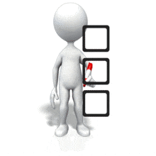
COVID Stress Scale
Take the quiz:
https://coronaphobia.org/list/

Slide 5
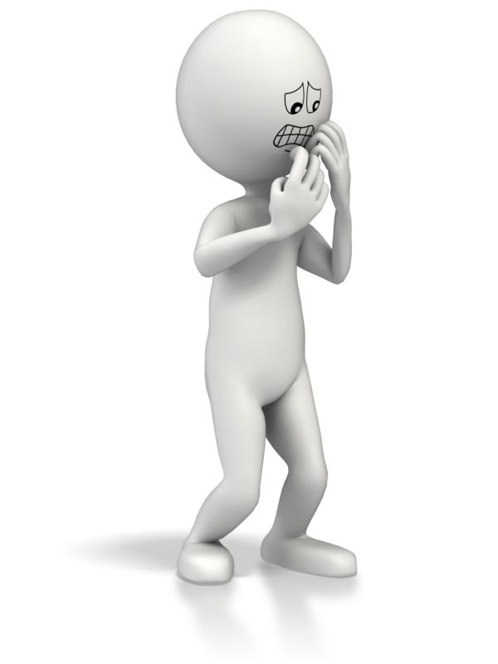
Accept that Anxiety and Fear are Normal
COVID-19 is new and we continue to learn new information as it evolves.
This can cause anxiety and fear.
A healthy amount of anxiety can be normal:
It can motivate us to protect ourselves and others.
It can motivate us to learn more about the virus.

Slide 6
Seek Credible Information
There is a plethora of information out there on COVID-19.
Ensure it is accurate information by going to credible sources such as:
The World Health Organization
Government of Nova Scotia
Health Canada
Avoid unfamiliar websites and online discussion groups, as they are generally opinions, not facts.
Be cautious of social media and information on these sites as they may not be reliable sources.

Slide 7
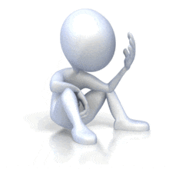
Avoid Information Overload
Limit checking sources of COVID-19 to once or twice a day.
Too much information is not always beneficial to our mental health.
This includes news, media, research articles, etc.
Information continues to shift rapidly, but daily changes of information will not impact your risk assessment.

Slide 8
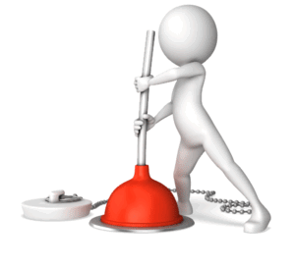
Intentionally Unplug
Disconnect from all electronics including phones, computers, social media, and tablets.
During these times, avoid social media and news.
Do something healthy for your mental and physical well-being such as exercise, read, go for a walk in nature, etc.

Slide 9
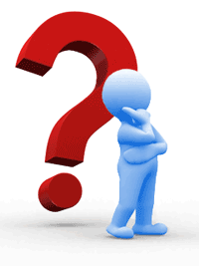
Deal with any Problems with a Process
Small problems may become overwhelming.
Identify which concerns are truly problems.
Some of your worries that you are experiencing may not be problems that need resolving.
See the following link for steps to resolve issues that arise: https://www.camh.ca/-/media/files/camh_covid19_infosheet-dealing_with_problems-pdf.pdf

Slide 10
Assess Your Stress Levels
Understand your stress levels.
When people experience too much stress, they feel a loss of control, worry excessively, experience negative emotions, and subsequently get overwhelmed.
To increase your coping capacity, you need to decrease your stress levels and identify your strengths.
Try following the quiz below to help with assessing your perceived stress: https://edc.camhx.ca/redcap/surveys/?s=MJYMXW9LTH
How much stress is too much quiz: https://edc.camhx.ca/redcap/surveys/?s=N93X9NLEXX

Slide 11
Be Careful of the What Ifs?
How will I cope IF I get sick?
These can cause you to focus on the negatives and you may not be able to identify positives or solutions.
During stressful times, people overestimate the negatives in situations. The statement above would force people to lay out all the repercussions of illness.
What about coping? People are more resilient and have numerous resources that they may not even consider.
Family, friends, community, workplace, provincial resources. All can help you cope and develop your abilities for resiliency.
Do NOT underestimate your abilities when faced with challenges. Identify your strengths and move forward with focussing on those and building on your existing skills.

Slide 12
Challenge your Anxious Thoughts
High anxiety levels are fuelled by our thought processes.
Thoughts can be so vivid, you feel they are true, such as:
“There is nothing I can do” or
“I can’t cope with that”
These thoughts are not facts but you believe them to be true.
How do we know if these are true or simply long held beliefs?
Try following the link to challenge your worries and anxieties.
https://www.camh.ca/-/media/files/camh_covid19_infosheet-challenge_worries-pdf.pdf

Slide 13
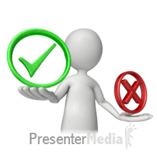
Decrease your Other Stressors
COVID-19 is unlikely the only source of stress in everyone’s life at the moment.
Having an abundance of stress can be detrimental to your health.
Address stressors that you have control over such as eating right, exercise, sleep, increasing your immunity, mental health-go out for a walk, etc.
Practice relaxation and meditation (choose an activity that works for you, start slowly, make it a regular habit).
Increase your positive coping strategies (such as staying active, get sufficient sleep, quiet time, etc.).
Decrease your negative coping strategies (such as drinking, smoking, etc.).
Avoid negativity and negative people.

Slide 14
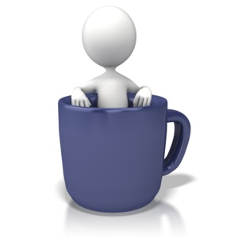
Moderate Your Caffeine Intake
Coffee intake is a daily routine for many.
Too much can make your heart race.
This can feed your anxieties.
Limit and stop your intake of caffeine early in the day to avoid a sleepless or restless night of sleep.

Slide 15
Be Kind to Yourself
Remember, you are only human
You may forget something.
You may not feel better right away.
You may just want a break and sleep in.
Look after yourself, or it can be difficult to look after your other responsibilities.

Slide 16
Be Realistic
If you get symptoms of COVID-19-get tested. Stay home!
Do not feel guilty about getting sick- do not place blame.
Remember not one preventative strategy for COVID-19 is 100%.
A combination of strategies is ideal, but the fact remains, you will never be 100% protected, unless you live in a bubble, so you need to find a way to move forward, to live life in a new normal.
Everyone will need to find and implement their own comfort measures and strategies to move forward as restrictions ease.
Everyone will be working at their own pace!

Slide 17
Stigma and Discrimination
Do not judge others for having a positive diagnosis, it can happen to any one of us.
Once restrictions ease, continue to practice your personal strategies to ensure your safety, both mental and physical.
See the following link to help with decreasing stigma and discrimination about COVID-19: https://www.camh.ca/en/health-info/mental-health-and-covid-19/stigma-and-prejudice

Slide 18
Facts vs Fear:
Follow the link to clarify the facts:
https://singingriverhealthsystem.com/coronavirus/facts-not-fear/

Slide 19
Seek Support
Just because you need to physical distance, does not mean you are unable to connect- reach out through:
Phone calls,
Video chat,
Outdoor activities.

Slide 20
I Still Can’t Cope!
You’ve reduced your stress and anxiety levels.
You have reached out to loved ones and community, now what?
Look for formal support if necessary to help you cope during stressful times. Normal life can cause increased stress and with the addition of a pandemic, life can become overwhelming quick. Try your family doctor, community walk-in clinics, online support groups, distress lines, psychologist, or other health professional. See the next slide for supports in Nova Scotia.

Slide 21
Click on the link to view the employee mental health resources:
https://www2.acadiau.ca/files/files/Files%20~%20Security/HealthHurdles/Mental%20Health%20Supports%20Employees.pdf
For student mental health resources, please visit our Student Counselling Centre at the following link:
https://www2.acadiau.ca/student-life/health-wellness/mental-health.html

Slide 22
Resources
A variety of resources:
https://coronaphobia.org/public-resources/
Coping with COVID-19 Anxiety
https://www.helpguide.org/articles/anxiety/coronavirus-anxiety.htm#
9 tips to help with worries of COVID-19
https://www.nhs.uk/every-mind-matters/coronavirus/covid-19-anxiety-tips/

Slide 23
Resources
Canadian Mental Health Association: Coping with COVID-19
https://novascotia.cmha.ca/community-capacity/coping-covid-19/
Protecting People with Disabilities:
https://www.canada.ca/en/public-health/services/diseases/2019-novel-coronavirus-infection/guidance-documents/people-with-disabilities.html
COVID-19 Self-Help Booklet Series:
https://www.camh.ca/en/health-info/mental-health-and-covid-19/faq-and-resources/self-help-booklet-series

Slide 24
References
https://news.berkeley.edu/2021/08/03/overcoming-pandemic-cave-syndrome-why-is-it-so-complicated/
https://www.camh.ca//covid19
https://www.camh.ca/en/health-info/mental-health-and-covid-19/coping-with-stress-and-anxiety
https://www.iflscience.com/health-and-medicine/cave-syndrome-the-worry-of-the-world-postlockdown-/
https://www.psychologytoday.com/ca/blog/the-pacific-heart/202105/cave-syndrome-viral-and-social-toxins-and-the-inner-life
https://www.scientificamerican.com/article/cave-syndrome-keeps-the-vaccinated-in-social-isolation1/

