Slide 1
Work- Life Balance Role Conflict Role Strain
Life is a Balancing Act

Slide 2
What is Work- Life Balance?
Making a bigger impact at work without sacrificing happiness and health.
Having a positive impact on your children and their lives
Being present in the moment.
Prioritizing what’s important (self-care) without guilt.
Having strong boundaries.
Letting go of trying to accomplish everything.
Therefore, work-life balance can be about feeling content in yourself and your decisions. It can be a mindset that you create.

Slide 3
Main Aspects of Work-Life Balance
Lack of time and scheduling conflicts.
Feeling overwhelmed, overloaded, or stressed due to the various roles required in life.

Slide 4
Negative Outcomes of Role Conflict at Work
Negative impact on organizational commitment
Decreased job satisfaction
Psychological distress
Interpersonal conflicts
Sickness and absence from work
Emotional exhaustion
Employee retention problems

Slide 5
Personal Negative Outcomes of Role Conflict
Interpersonal conflicts
Mental health effects such as depression and anxiety
Physical effects resulting from constant work, stress and the subsequent levels of hormones circulating in your system.
Inability to focus
Fatigue
Irritability
Compromised immune system
Sleep disturbances
Gastrointestinal issues

Slide 6
Why is Work-Life Balance Important?
Less stress on your health and in your life
Improves your mental health
Means better physical health
Enhances your ability to be present
Improves relationships
Increases engagement at work
Increases creative thinking
Makes you more productive
It brings you happiness and fulfillment
Brings higher levels of success

Slide 7
How Do I Create a Positive Work-Life Balance?
Say no to items that are not priorities and accomplish your priorities- being tactful is a skill.
Delegate if necessary.
Prioritize yourself and your well-being.
Create strong boundaries by making tough choices- you are only one person.
These strategies can create a manageable workload.

Slide 8
Mental Health
When you feel balanced, you can deal with negative emotions and thoughts better.
The human brain is not designed to continuously live under intense stress.
Creating a better life balance gives you space to breath and think allowing for subconscious thoughts to improve creativity.
This increases your resilience while understanding and processing your thoughts and emotions.
Start taking control of your thought processes to create a more balanced life.

Slide 9
By Prioritizing Yourself
You improve your physical health
Eat healthy meals
Reduce sugar and alcohol intake
Healthy sleep habits
Humans are not designed to sit all day or be cooped up indoor- get active, get regular exercise and get outdoors.
These habits generate endorphins to help you feel better and help maintain a healthy immune system.

Slide 10
Distracted? Racing Mind?
Practice mindfulness and intentionally focus.
Clear your mind from your tasks, even for short periods of time- take a mental break.
Mindfulness helps you be aware of the good around you, helps with empathy, and therefore, improves your interpersonal relationships.

Slide 11
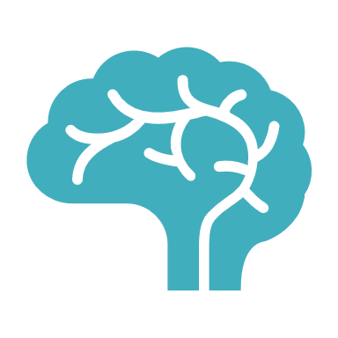
Your Brain Needs Space to Think
Your brain is not meant to be bombarded by people, social media, email, phone calls, and technology at all times.
Create a space for clear, creative thinking.
A balance allows creativity and solutions to problems to develop.
Balancing your life can result in increased productivity, which in turn increases your work-life balance.

Slide 12
Happiness and Fulfillment
Balance is about feeling good about yourself and feeling you are in control of your life.
Small changes can impact your thought processes and provides a positive outlook on life, contributing to happiness and a sense of fulfillment.
Prioritize what is important and ensure to include yourself on the list.

Slide 13
What Can You Do?
Work-Life Negotiation/ Balance
Life is a balancing act
Some days you can give a little more to work, but you need to realize that this will impose on your personal time.
On the other hand some days you give more to your personal life as priorities arise, which leaves less time for work.
You need to learn to balance the various roles in your work life and personal life to manage your time and energies while considering individual priorities and needs.

Slide 14
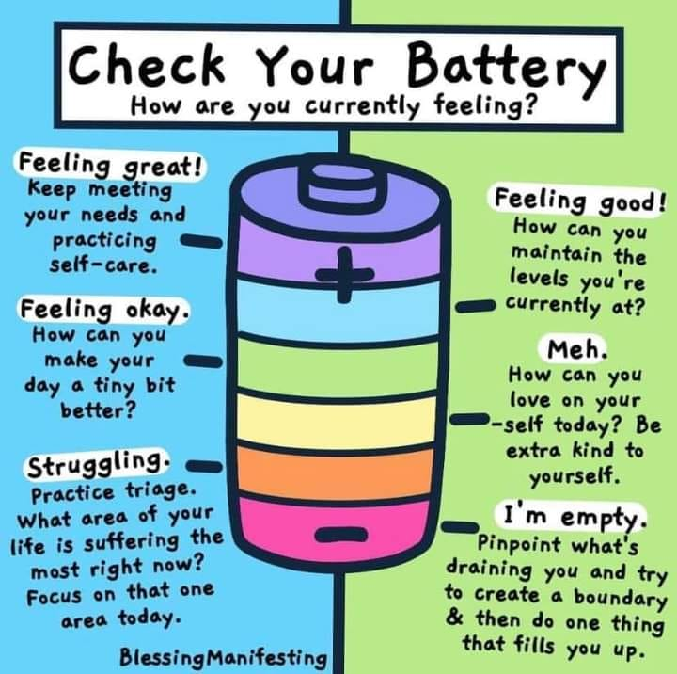
Importance of Investing in Yourself
Fatigue can be detrimental to your physical and mental health.
Fatigue can include:
Your mental state, such as reduced mental capacity, inattentiveness, and indecisiveness.
Your physical state such as physical exhaustion, weakness, and physiological weakness, or
Your subjective stage such as drowsy, weary, sleepy, lethargic, or tired.
Fatigue can impact your entire life from home, work performance, driving abilities, and social interactions.
For factors that impact fatigue and how to address fatigue visit the following link: https://www.ccohs.ca/oshanswers/psychosocial/fatigue.html

Slide 15
What Can Your Employer Do?
Invest in your employees, not just as professionals, but as people too.
Invest in benefits, policies, and/ or programs that help create a better balance between the demands of their job and the healthy management of life outside work (ex; on-site childcare, employee assistance programs, fitness facilities, training opportunities, etc.).
Avoid placing workers in jeopardy by analyzing working conditions and addressing operational safety.
To avoid fatigue, implementing shorter shifts with work rotation schedules that go with the direction of the sun (morning, afternoon, night) have been found to be effective

Slide 16
Resources
The Federal Government and Canada Labour Code:
https://www.canada.ca/content/dam/canada/employment-social-development/services/labour-standards/reports/balancing-work-home-life/balancing-work-home-life-EN.pdf
A great video about work-life balance:
https://youtu.be/jdpIKXLLYYM

Slide 17
Resources
Skills to help with improving your work-life balance such as active listening skills, addressing conflicts, etc.:
https://www.ccohs.ca/topics/wellness/mentalhealth/?=undefined&wbdisable=true

Slide 18
References
https://canadasafetycouncil.org/fatigue/
https://www.ccohs.ca/oshanswers/psychosocial/worklife_balance.html
https://www.coursecorrectioncoaching.com/reasons-why-work-life-balance-is-important/
https://www.forbes.com/sites/forbescoachescouncil/2021/03/16/work-life-balance-is-a-thing-of-the-past-now-its-all-about-work-life-negotiation/?sh=7a8e7f4e51ab
https://www.hrzone.com/hr-glossary/what-is-work-life-balance
https://www.ilkogretim-online.org/?mno=87599

